Slide 1
Project Presentation
AIT 526
Kasey Howlett
Sai Sushmitha Kadambari
Chi Quinn
Evans Sarker

Slide 2
Abstract
Since early 2021, the world has been facing steady inflation. As a result, grocery prices are steadily increasing. In addition, choosing what to make for dinner, with an abundance of options, can lead to decision fatigue. These challenges create an avenue for a solution to alleviate decision fatigue while also reducing spending. This project utilizes natural language processing and cosine similarity to provide suggested recipes based on pantry stock. A corpus of recipes from the Epicurious website contains recipe titles and ingredients. The data is preprocessed using several NLP techniques such as lemmatization, tokenization, and pos tagging. A given list representing pantry stock is compared iteratively against all existing data in the corpus to provide a Top 5 list of most probable recipes. Testing involved comparing an existing recipe from the original corpus to the entire corpus for accuracy. The value provided by this project includes a working system for providing recipe recommendations for a given user. The working system makes the most of available ingredients while also taking away the need to make decisions from a user.
Key words: Natural language processing, Machine Learning, Cosine Similarity, Python, Recipe, Ingredients

Slide 3
Introduction
Decision fatigue caused by the daily task of choosing what to cook for dinner
Steady inflation of grocery prices since early 2021
Notes:
ES

Slide 4
Related Work
Lack of artificial intelligence and machine learning in culinary applications (Chaudhary et al., 2022)
Similarity calculation (Vivek, N. Manju and M.B., 2017)
Item based: Tanimoto Coefficient. Log Likelihood
User based: Euclidean Distance, Pearson Correlation
Generating recipes
Seq2seq models, transformer-based architectures (Chaudhary et al, 2022)
Evolutionary genetic algorithm (Galanis and Papakostas, 2022)

Slide 5
Objective
Address common challenges individual faces in meal planning
Create a robust recipe prediction system
Simplify meal planning process for individuals

Slide 6
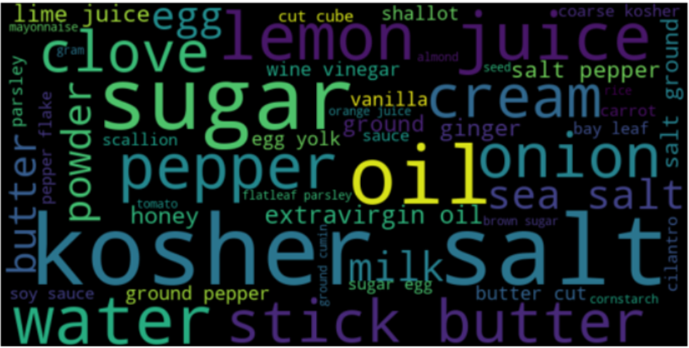
Selected Dataset
Food ingredients and recipes dataset from Epicurious, via Kaggle
Over 13,000 recipes (rows)
Columns Include:
Title
Ingredients
Instructions
Word cloud of food items (ingredients)

Slide 7
Proposed System
Focus on functionality of the tool
User provides input of food ingredients
Backend of tool includes a data store of recipes
Includes NLP methods and machine learning

Slide 8
Proposed Development Platform
Main Platform: Python
Pandas, NLTK, Beautiful Soup
Testing: Jupyter Notebook
Examine Results Output: Microsoft Excel
Notes:
ES

Slide 9
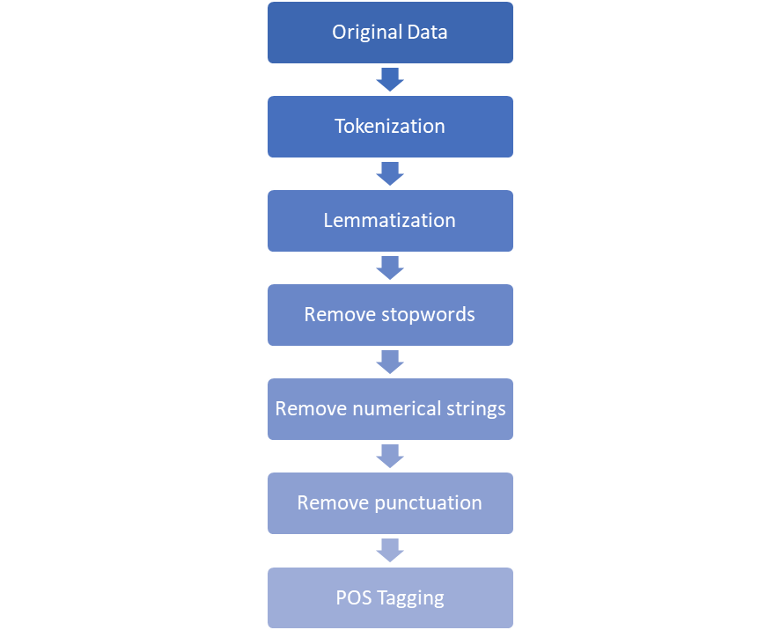
Data Pre-processing
¾ cup (120g or 4 ½ oz) toasted pepitas
[¾, cup, (120g, or, 4 ½, oz), toasted, pepitas]
[¾, cup, (120g, or, 4 ½, oz), toast, pepitas]
[¾, cup, (120g, 4 ½, oz), toast, pepitas]
[cup (g oz) toast, pepitas]
[cup, g, oz, toast, pepitas]
[cup,g, oz, toast, pepitas]
[pepitas]

Slide 10
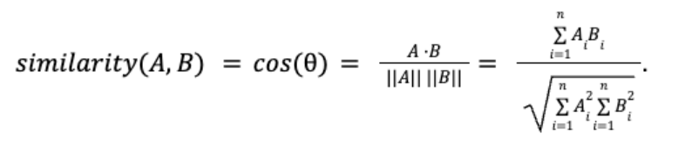
Baseline Solution
Cosine Similarity
Vectorize strings of words to determine a similarity score
Example output
[0.99, ‘Miso-Butter Roast Chicken With Acorn Squash Panzanella’]
[0.66, ‘Grilled Corn on the Cob with Salt-and-Pepper Butter’]
[0.65, ‘Garlic-Brown Butter Croutons’]

Slide 11
Proposed Solution and Preliminary Results
Initial solution for recipe suggestions was effective but had limitations.
Issue: Unnecessary words like measurements (cups, pounds, etc.) affected similarity scores.
Proposed solution: Implement a word removal function for these words.
After second iteration, results improved:
[1.0] 'Miso-Butter Roast Chicken With Acorn Squash Panzanella'
[0.66] 'Grilled Corn on the Cob with Salt-and-Pepper Butter'
[0.66] 'Garlic–Brown Butter Croutons'
Scores increased, confirming hypothesis that measurement words impacted similarity.

Slide 12
Final Work
Improve user output.
Current approach: List top 5 recipes in console.
Selection based on ingredient similarity scores.
Recipes and details saved in a text file for user convenience.

Slide 13
Complications and Errors
Main challenge: Removing excess words.
NLTK stopwords tool not tailored to this problem.
Custom list of measurement words for quantity removal.
Issue with similar words like "salt" and "kosher salt."
Requires custom pre-processing for accurate interpretation

Slide 14
Conclusion
Solution was a success as tool offers recipe suggestions from user input.
No custom User Interface, but achieves intended purpose.
Validates the NLP and ML hypothesis for recipe suggestions.
Effective methods of Lemmatizing, POS tagging, cosine similarity.
Cosine similarity ideal for vectorizing ingredient lists.
Compares user input to the recipe corpus for suggestions effectively.

Slide 15
Future Work
Filtering recipes by specific categories.
Customization for users: diet information options.
Catering to diverse food plans and macronutrient needs
Plan to add additional data sources.

Slide 16
References
Carmody, Deidre (1995, May). “THE MEDIA BUSINESS; Conde Nast to Jump into Cyberspace”. The New York Times. Retrieved September 25, 2023, from https://www.nytimes.com/1995/05/01/business/the-media-business-conde-nast-to-jump-into-cyberspace.html
Chamblee, B. (2022, February 12). What is Cosine Similarity? How to Compare Text and Images in Python. Medium. https://towardsdatascience.com/what-is-cosine-similarity-how-to-compare-text-and-images-in-python-d2bb6e411ef0
Chaudhary, S., Soni, B., Sindhavad, A., Mamaniya, A., Dalvi, A., & Siddavatam, I. (2022). ChefAI.IN: Generating Indian recipes with AI algorithm. 2022 International Conference on Trends in Quantum Computing and Emerging Business Technologies (TQCEBT). https://doi.org/10.1109/tqcebt54229.2022.10041463
Epicurious. (n.d.). Epicurious – Recipes, Menu Ideas, Videos & Cooking Tips. Epicurious. Retrieved September 25, 2023, from https//www.epicurious.com/
Galanis, N.-I., & Papakostas, G. A. (2022). An update on cooking recipe generation with machine learning and Natural Language Processing. 2022 IEEE World Conference on Applied Intelligence and Computing (AIC). https://doi.org/10.1109/aic55036.2022.9848929
Goel S., Desai, A. & Tanvi. (2019, February). Food Ingredients and Recipes Dataset with Images. Version 1. Retrieved September 11, 2023, from https://www.kaggle.com/datasets/pes12017000148/food-ingredients-and-recipe-dataset-with-images/data
Majumder, B. P., Li, S., Ni, J., & McAuley, J. (2019). Generating personalized recipes from historical user preferences. Proceedings of the 2019 Conference on Empirical Methods in Natural Language Processing and the 9th International Joint Conference on Natural Language Processing (EMNLP-IJCNLP). https://doi.org/10.18653/v1/d19-1613
Oesper, L., Merico, D., Isserlin, R., & Bader, G. D. (2011). WordCloud: a Cytoscape plugin to create a visual semantic summary of networks. Source Code for Biology and Medicine, 6 (1), 7.
Pignatiello, G. A., Martin, R. J., & Hickman, R. L., Jr (2020). Decision fatigue: A conceptual analysis. Journal of health psychology, 25(1), 123–135. https://doi.org/10.1177/1359105318763510
Vivek, M. B., Manju, N., & Vijay, M. B. (2017). Machine learning based food recipe recommendation system. Proceedings of International Conference on Cognition and Recognition, 11–19. https://doi.org/10.1007/978-981-10-5146-3_2

